Slide 1
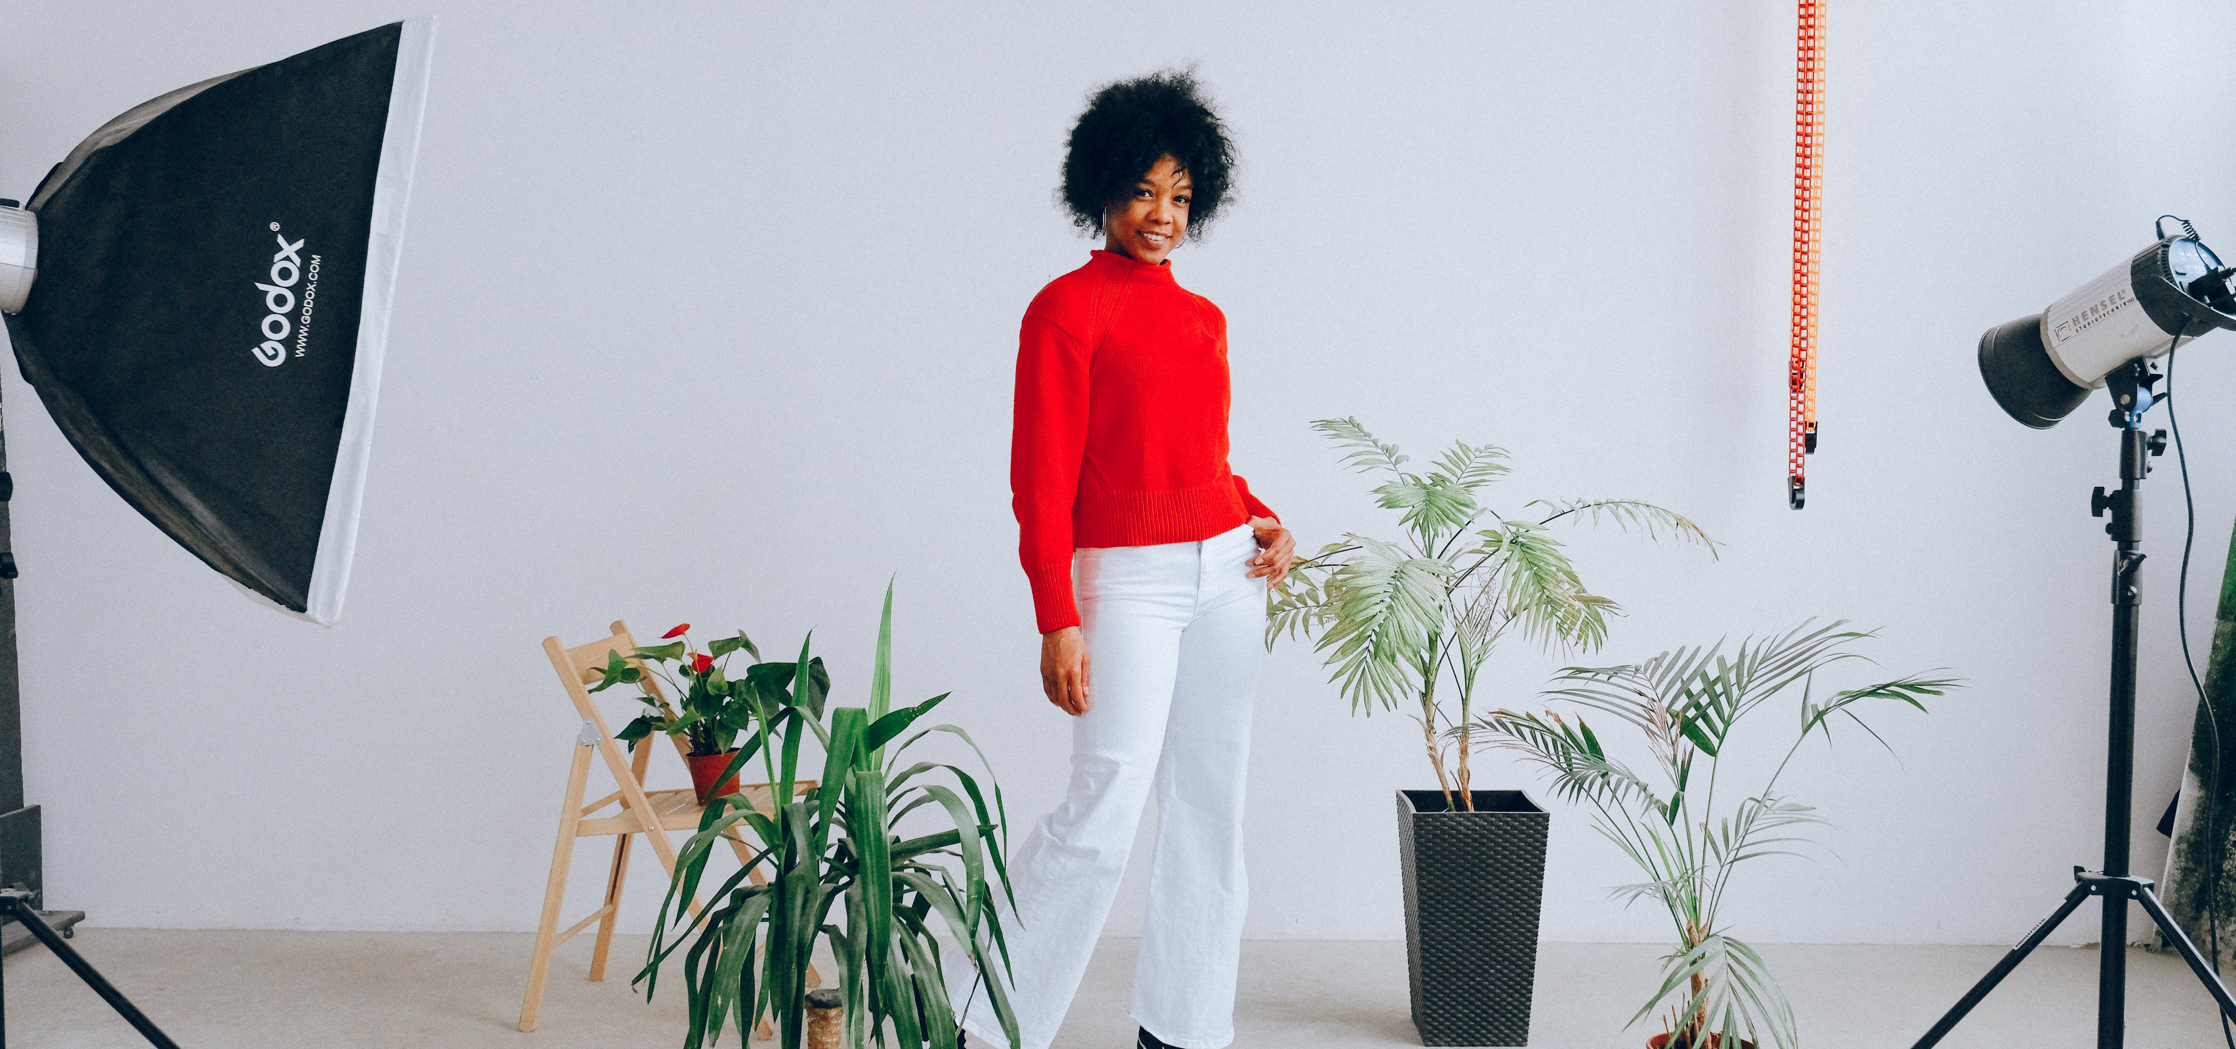
INNOVISION
Notes:
LEWIS

Slide 2
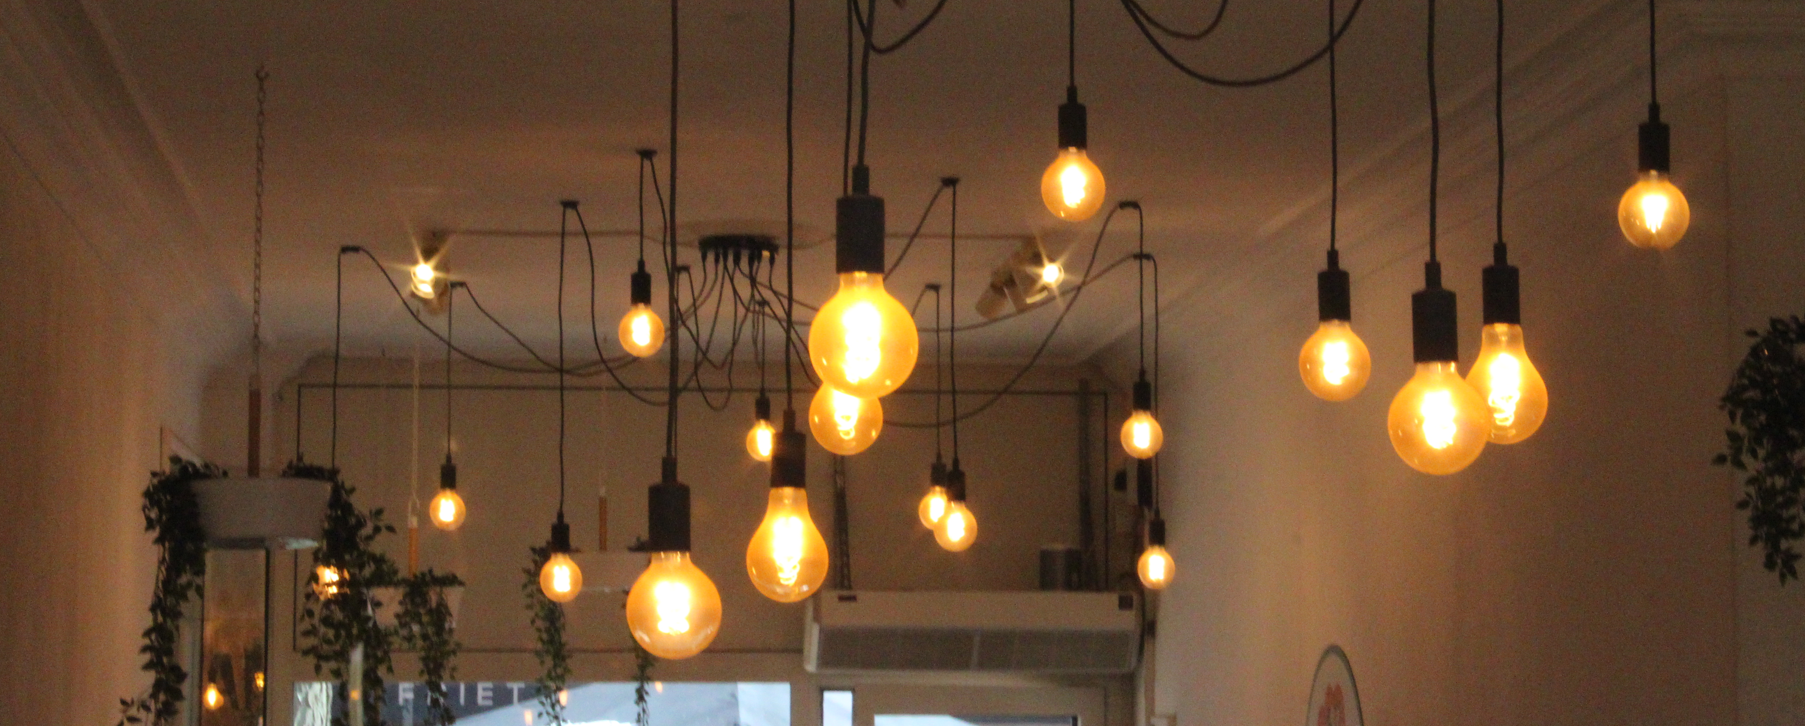
“Brightness is the currency of a vibrant life”
Notes:
LEWIS

Slide 3
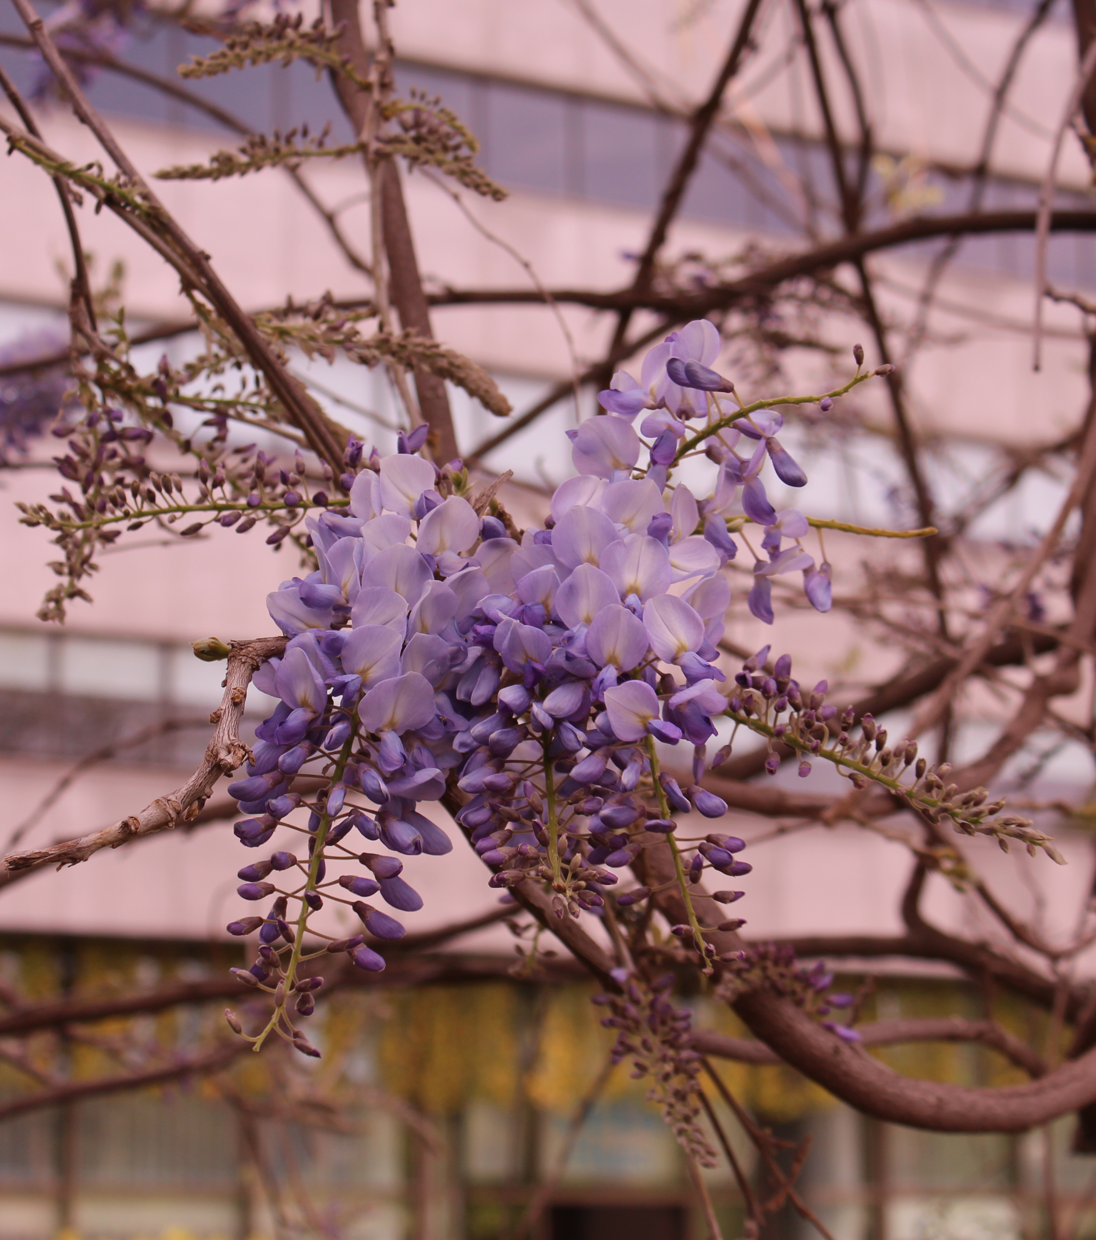

We are Team Innovision. We are the team responsible for creating instructions for the lights in the pixel playground. With our help, you will become a pro at setting up the lights however you want.
Notes:
LEWIS

Slide 4

CURRENT SITUATION
Students don't know how to use the lighting in the Pixel Playground
Why? There aren't any tutorials or manuals available (informative guidelines*)
This could lead to problems and high costs
Notes:
LEWIS

Slide 5
Objectives
Creating easy to understand tutorials
Having tutorials on paper + video tutorials
Adding visuals to the paper tutorials
Informing students of proper safety
Notes:
OWEN

Slide 6
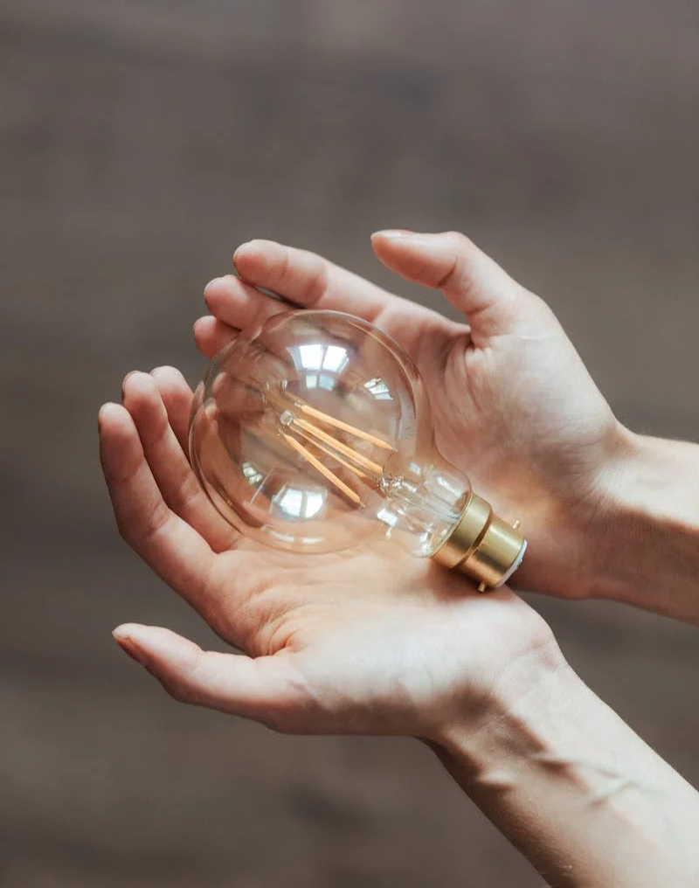
Proposed solutions
We intend to pass off proper safety knowledge
Video tutorials for visual learners
Short descriptions including key info
Long in-depth descriptions to cover all info
Step by step for ease of setup of the lights
Notes:
OWEN

Slide 7
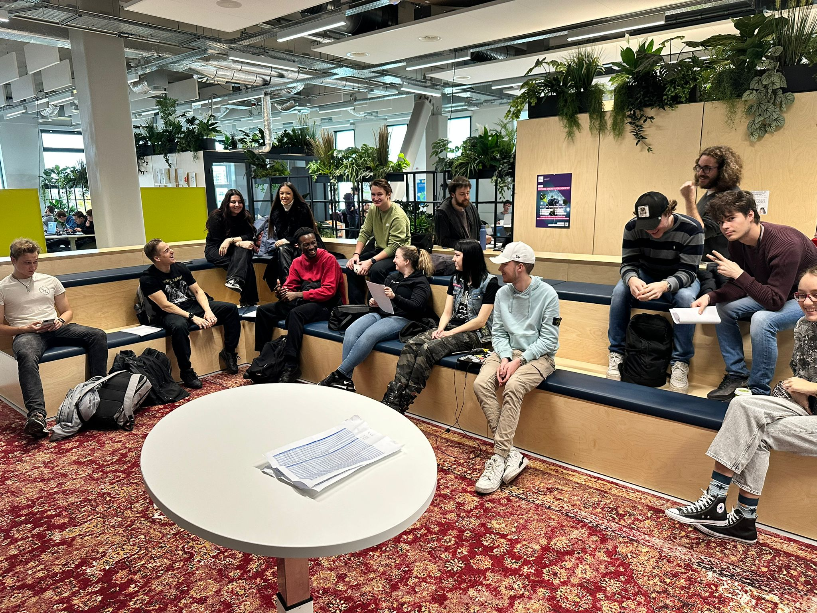
Important meetings
The Innovision team has attended meetings to discuss with other groups
We asked for recommendations, and gave the other groups our own input.
This helped us create the style guide everybody has to follow
Notes:
SINA

Slide 8
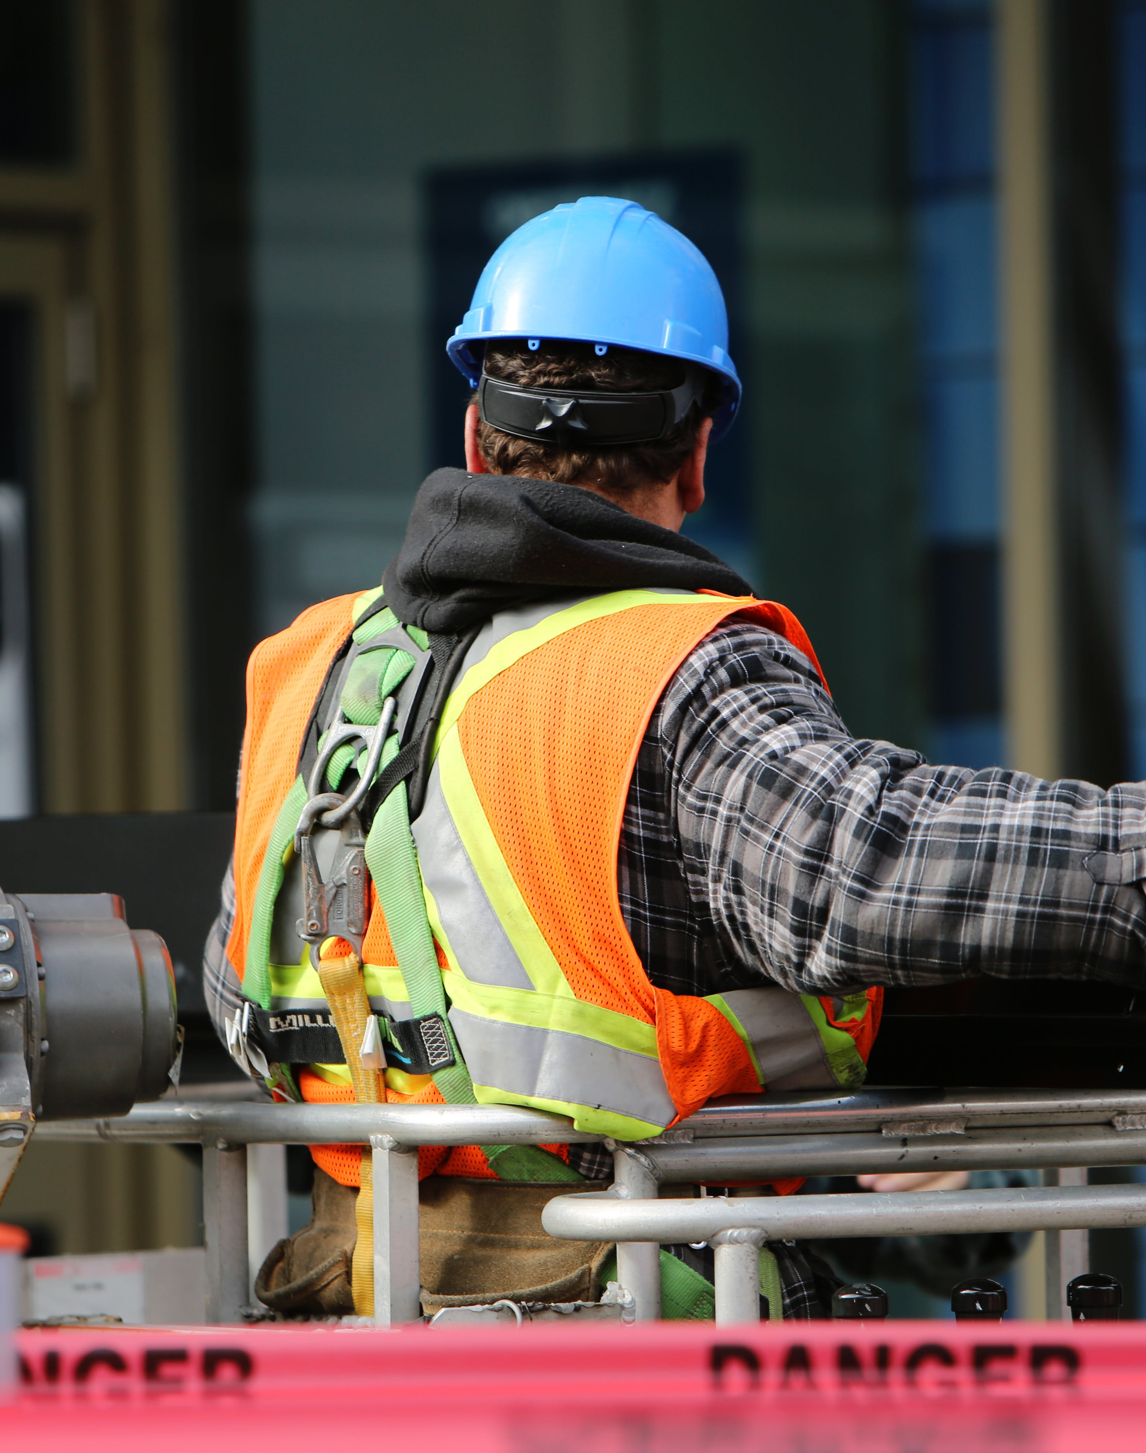
SAFETY FIRST
Emphasize dangers of different lights
Include corresponding warnings
Reduce risk of lights breaking or users hurting themselves
Enhance financial safety for Pixel Playground
Lights handled with care for increased longevity
Decrease the need to buy new equipment annually
Notes:
SINA
We want to emphasize the dangers of the different lights and Including their corresponding warnings.
This reduces the risk of the lights breaking or the users hurting themselves.
By adding the safety, it also adds to financial safety to pixel playground since the lights will be handled with care, therefore increasing longevity and reducing the need to buy new equipment every year.

Slide 9
User-Friendly Design
The front page gives a warning for the equipment's and basic explanation of the manuals purpose
Table of contents for accessibility and ease of navigation
Short description for key features
Long description for in-depth analysis
Borders in the colors of the Pixel Playground branding
Notes:
SINA

Slide 10
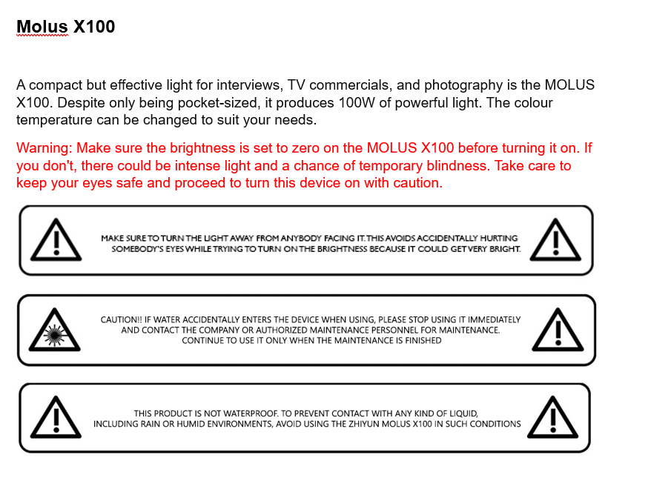
Notes:
KYLE

Slide 11
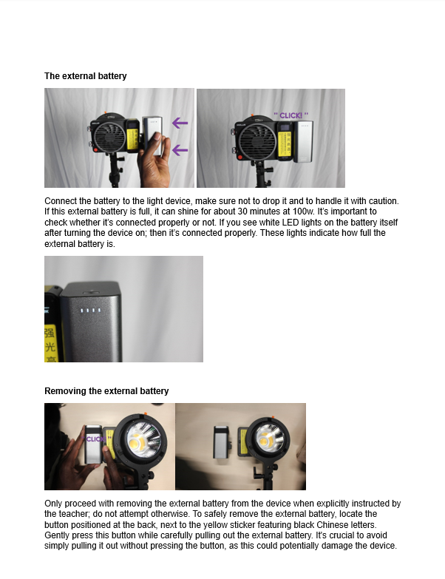
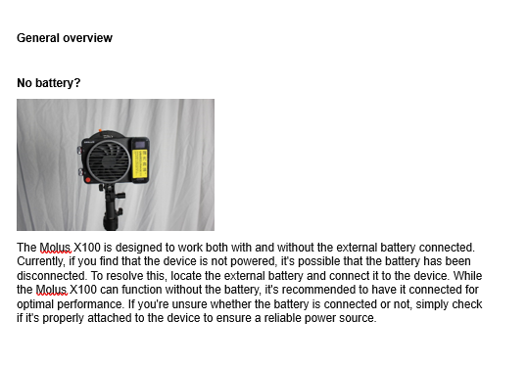
Notes:
KYLE

Slide 12
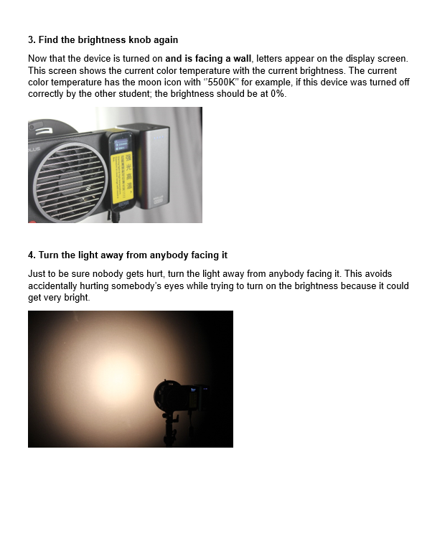
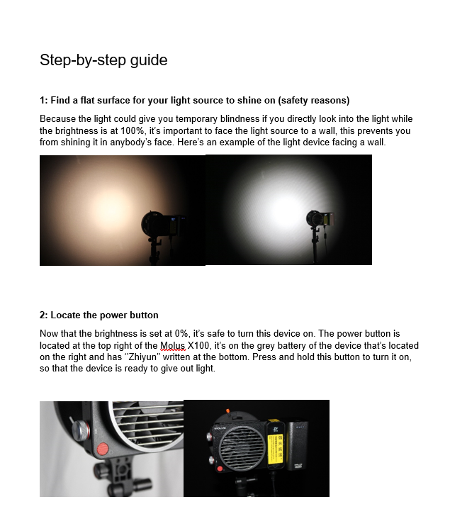
Notes:
KYLE

Slide 13

START
END
NOTION
START TO FINISH
Displaying the timeline with all task
Showing the progress from the beginning to the end
Notes:
ZACH

Slide 14
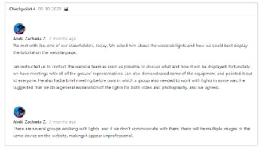
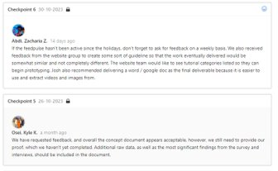
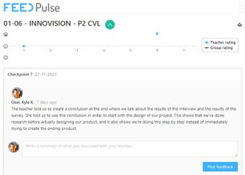
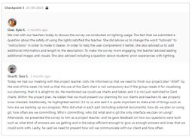
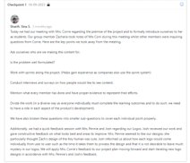
Feedback
Notes:
ZACH

Slide 15
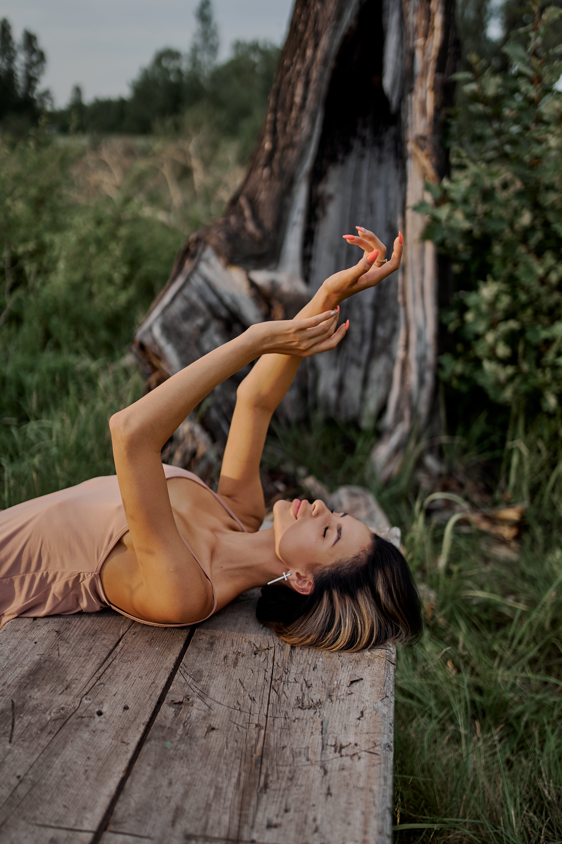
Future plans
Creating video's that make the manuals even more clear
Making high quality audio recordings for the video
Putting the manuals into the template that follows the style guide (pdf)
Notes:
ZACH

